Slide 1


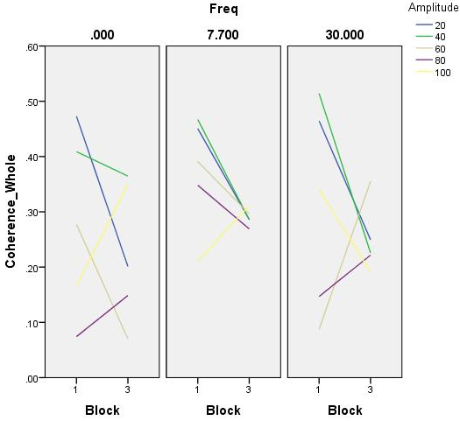
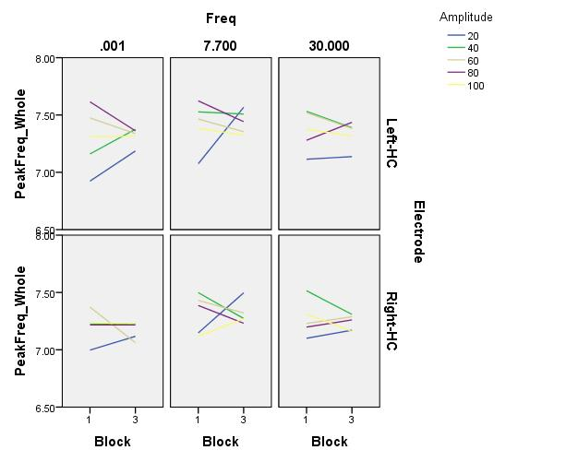
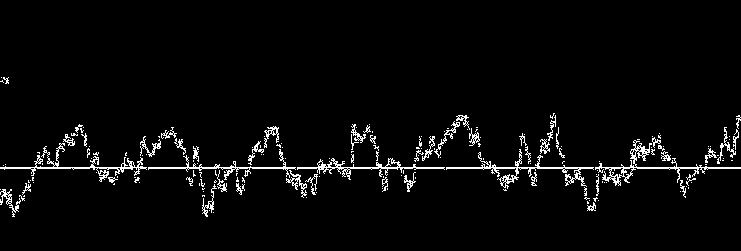
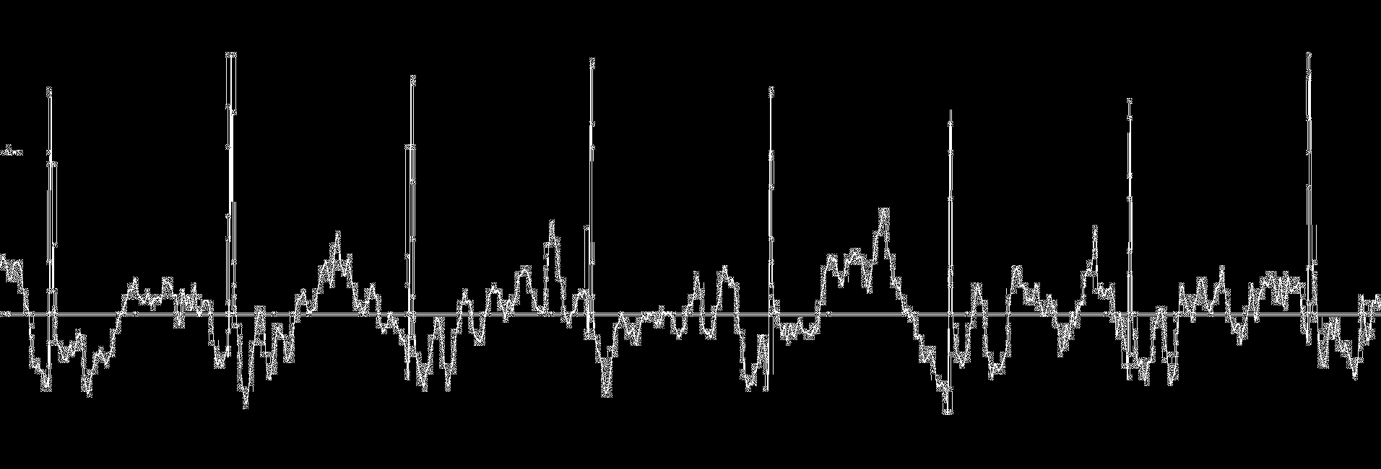
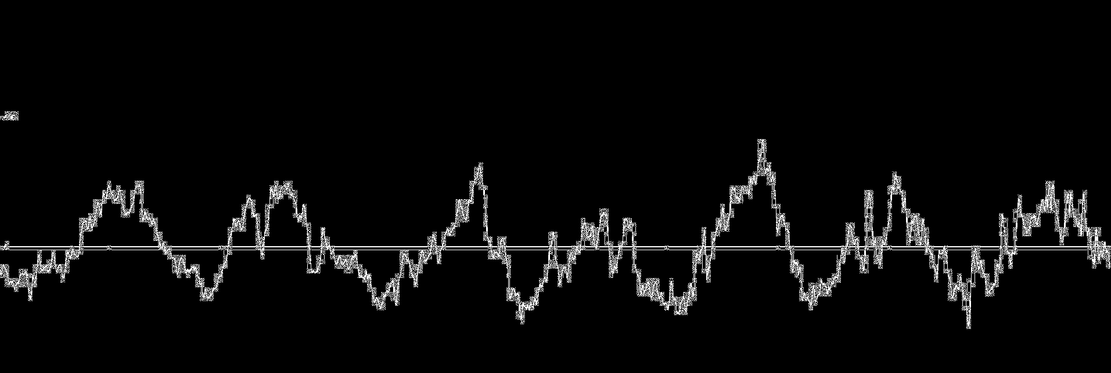
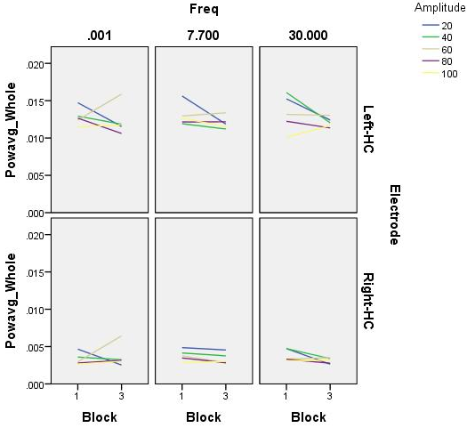
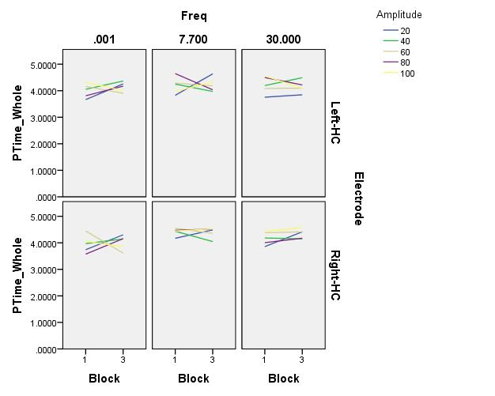
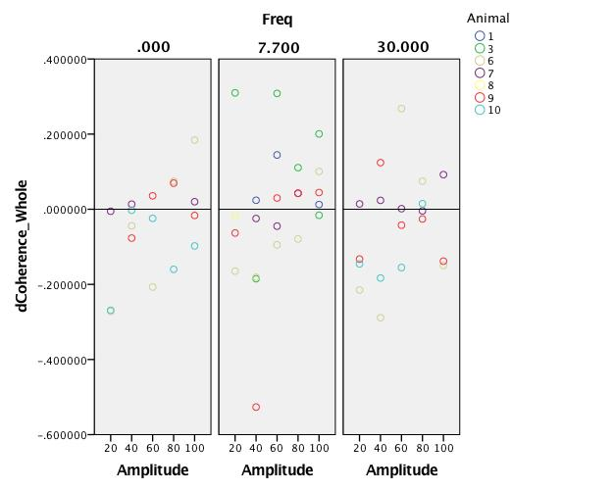
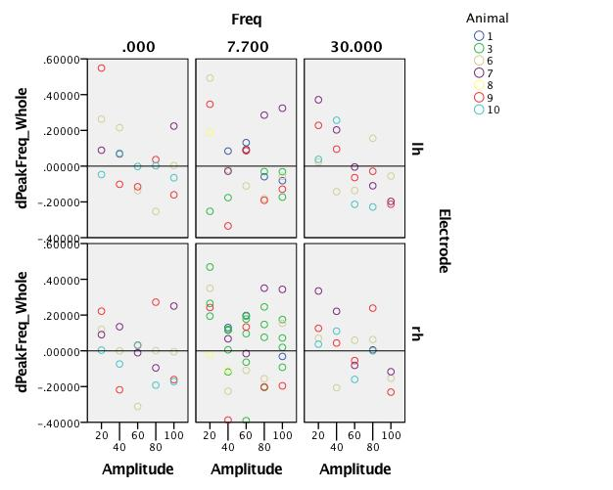
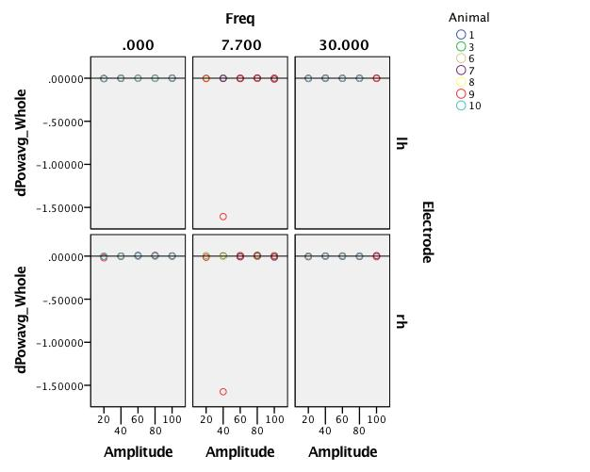
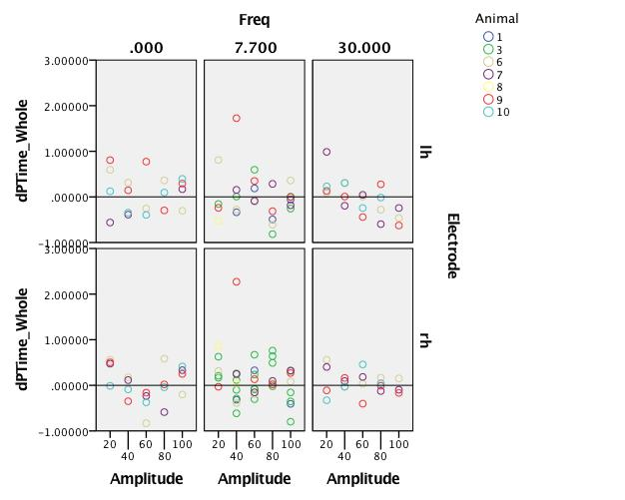
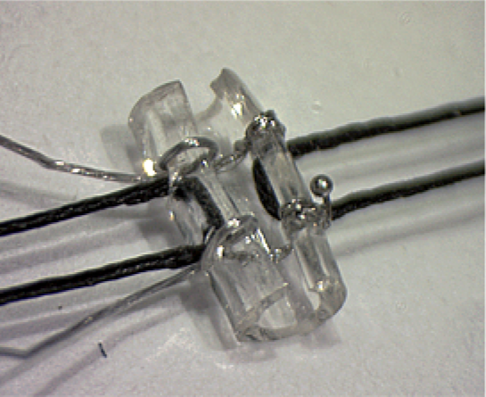
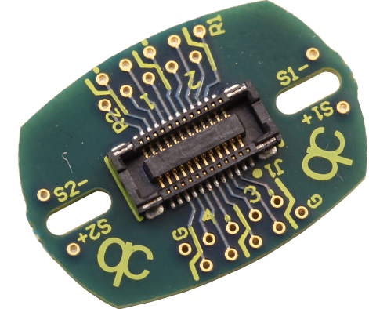
Vagal Nerve Stimulation to Drive Hippocampal Theta Oscillations in Rats
Arjang Ahmadpour, Ali Izadi, Brenden Cohn-Sheehy, Lucy Ogbu-Nwobodo, Kiarash Shahlaie, Gene Gurkoff
Department of Neurological Surgery, University of California, Davis, CA, USA
Introduction
Results
Conclusions
Epilepsy is a chronic neurological condition that affects approximately 2.2 million Americans. The cost of diagnosing and treating intractable epilepsy in the United States alone is as high as 4 billion dollars annually. Despite the introduction of newer antiepileptic drugs, approximately 880,000 epileptic patients have poor seizure control with medications alone. Furthermore, over half of these patients exhibit chronic learning and memory deficits that dramatically impact their quality of life. Vagal Nerve Stimulation utilizes high frequency electrical current that travels up the vagal nerve to the brain and penetrates the blood brain barrier. The introduction of this electrical activity into the brain of epileptic patients interrupts the pathological synchronous neuronal activity that is a primary characteristic of seizure activity. This intervention reduces seizure frequency in a select group of patients with epilepsy, but does not improve the memory deficits many patients experience. Previous studies have demonstrated that the hippocampus, an area of the brain that plays a critical role in learning and memory functions, generates low frequency electrical activity in the 6-10Hz range. This frequency is termed Theta. Despite pre-clinical and clinical data demonstrating the importance of theta oscillations in cognitive functioning, low frequency stimulation of the vagus nerve and its effect on the hippocampus have not been evaluated.
Temporal lobe epilepsy (TLE) is the most prevalent classification of partial epilepsy and is associated with persistent deficits in cognition. Hippocampal network dysfunction and a reduction in theta oscillations are correlated with diminished spatial learning. Vagal nerve stimulation (VNS) is an adjunctive therapy for patients with medically refractory epilepsy that was FDA-approved in 1997. Theta frequency range (6-10Hz) hippocampal oscillations play a critical role in facilitating episodic and short-term memory tasks¹, arousal and sensorimotor processing ^{2,3}, and spatial working memory and navigation ⁴⁻⁷. An increase in theta power is associated with encoding of episodic memory in humans ⁴. There is also evidence of an increase in hippocampal theta activity prior to successful memory retrieval ^{4,8}. Animal studies have previously demonstrated a
correlation between theta rhythms and memory storage ^{4,9} as well as behavioral learning ^{4,10}. These past discoveries demonstrate the importance of theta activity in normal memory function ⁴.
Fig 2: Hippocampal Oscillations
Fig 4: Frequency Dependence and Coherence
EEG:
Possible dose or time-dependent changes were observed in differences between pre-stimulation and post-stimulation theta coherence and peak frequency, across subjects and stimulation frequencies.
No frequency dependent responses were observed within subjects.
No trends in coherence were observed for low, mid, and high gamma bands.
More exhaustive analyses are needed to characterize possible chronic changes in EEG in stimulated animals.
A
B
A
B
C
D
Methods
1 Second
Fig 2: (A) Hippocampal oscillations are generated and maintained by multiple inputs, both directly (blue arrow) and indirectly (green arrows). Oscillations from the hippocampus project broadly (red arrows) to both cortical and subcortical nuclei. Hippocampal traces demonstrating (1 sec, 1-250 Hz filtered) EEG (B) prior to stimulation, (C) during 7.7 Hz stimulation, (D) immediately after stimulation.
Subjects
7 adult male Sprague-Dawley rats are included in this study.
Electrode Placement
Tungsten monopolar electrodes were stereotactically implanted in the left/right hippocampus (AP=+3.3, ML=±2.0, DV=-3.8).
Vagal Nerve Stimulator Placement
A vagal nerve cuff with bipolar (anode+cathode) stimulating electrode composed of Micro-Renathane and stainless steel wires was implanted around the left vagal nerve.
Recovery
Animals given 2 weeks to recover from surgery.
Baseline EEG Recordings
Custom Matlab script (P_episode) was used to determine percent time oscillating in theta (6-10 Hz). P_episode calculates a background threshold and uses strict power and duration thresholds to determine true oscillations.
Fig 3:Differences Between Pre-Stimulation and Post-Stimulation
Future Directions
A
B
More complex analyses of EEG at individual nodes as well as across the circuit:
  Epoch specific analysis.
  Phase coherence.
  Cross frequency coherence.
Compare multiple stimulation paradigms across larger animal groups:
  Frequency (i.e. theta, gamma, theta burst, bypass).
  Timing (i.e. continuous, intermittent, responsive).
  Increased number of EEG Targets (i.e. thalamus, entorhinal cortex, MSN).
Analyze “Cycle” stimulation data for Animal # 6 and Animal # 9.
Reexamine stimulation/recording apparatus to rule out causes of stimulation artifact & clipping.
Record in a behavioral apparatus (e.g. T-maze) to allow video tracking.
Begin stimulation paradigm studies in animal cohorts with pilocarpine induced seizures.
Vagal Nerve Stimulation (VNS) Paradigm with EEG Recording
Refer to Figure 1 for stimulation frequencies per day of recording, per animal
Three stimulation blocks per trial: 2 minutes baseline, 2 minutes stimulation, 2 minutes post-stimulation
Five successive trials per day: 20uA, 40uA, 60uA, 80uA, 100uA.
Cycle Trials (Not yet processed/analyzed)
Animals 6 and 9 received two days of cycled stimulation: 7.7 Hz, 1 minute on, 4 minutes off for a total of 30 minutes per day.
Fig 3:
Fig 4: These example plots represent Animal 6. (A) No frequency dependent trends were observed within subjects and (B) No trends in coherence were observed for low, mid, and high gamma bands.
Fig 5: Implantable VNS Cuff and EIB Board
C
D
  Fig 3: Notice in the two figures that, at 20-40uA, (A) differences between pre- and post-stimulation coherences or (B) peak frequencies, respectively, are clustered either below or above zero (negative or positive differences), but subsequent blocks (at higher stimulation amplitudes) appear to shift to the other side of zero.
  it is possible that increasing doses have an effect on coherence and peak frequency, but if so, this could be due to either increasing amplitudes or mere repetition. This may also be confounded by the factor of advancing time. This pattern was not observed for (C) average power, but was possibly observed for (D) percent time.
Rodent VNS Cuff
Figure 1. Stimulation Schedule
EIB*
Group | Animal # | Monday | Tueday | Wednesday | Thursday | Friday
1 | 1, 3 | 7.7Hz | 7.7Hz | 7.7Hz | 7.7Hz | 7.7Hz
2 | 8,9 | 0Hz | No Stim | 7.7Hz | No Stim | 30Hz
3 | 6,7 | 7.7Hz | No Stim | 30Hz | No Stim | 0Hz
4 | 10 | 30Hz | No Stim | 0Hz | No Stim | 7.7Hz
References
Vertes RP. Hippocampal theta rhythm: a tag for short-term memory. Hippocampus. 2005;15(7): 923-35.Review. PubMed PMID: 16149083.
Green, J. D. and A. A. Arduini (1954). "Hippocampal electrical activity in arousal." Journal of neurophysiology 17(6): 533-557.
Vanderwolf, C. H. (1969). "Hippocampal electrical activity and voluntary movement in the rat." Electroencephalography and Clinical Neurophysiology 26(4): 407-418.
Lee, D. J., G. G. Gurkoff, A. Izadi, R. F. Berman, A. D. Ekstrom, J. P. Muizelaar, B. G. Lyeth and K. Shahlaie (2013). "Medial septal nucleus theta frequency deep brain stimulation improves spatial working memory after traumatic brain injury." J Neurotrauma 30(2): 131-139.
Buzsaki, G. (2005). "Theta rhythm of navigation: link between path integration and landmark navigation, episodic and semantic memory." Hippocampus 15(7): 827-840.
McNaughton, N., M. Ruan and M. A. Woodnorth (2006). "Restoring theta-like rythmicity in rats restores initial learning in the Morris water maze." Hippocampus 16(12): 1102-1110.
Mizumori, S. J. Y., G. M. Perez, M. C. Alvarado, C. A. Barnes and B. L. McNaughton (1990). "Reversible inactivation of the medial septum differentially affects two forms of learning in rats." Brain Research 528(1): 12-20.
Addante, R. J., A. J. Watrous, A. P. Yonelinas, A. D. Ekstrom and C. Ranganath (2011). "Prestimulus theta activity predicts correct source memory retrieval." Proceedings of the National Academy of Sciences of the United States of America 108(26): 10702-10707.
Darling, R. D., K. Takatsuki, A. L. Griffin and S. D. Berry (2011). "Eyeblink conditioning contingent on hippocampal theta enhances hippocampal and medial prefrontal responses." Journal of Neurophysiology 105(5): 2213-2224.
Landfield, P. W., J. L. McGaugh and R. J. Tusa (1972). "Theta rhythm: A temporal correlate of memory storage processes in the rat." Science 175(4017): 87-89.
*Electronic Interface Board
  Acknowledgments: This project was supported by the UC Davis Department of Neurological Surgery, the T32 Institutional National Research Service Award, and the Bronte Epilepsy Research Foundation.Thank you to Kia Shahlaie, Gene Gurkoff, Darrin Lee, Ali Izadi, and Alex Pevzner for making this project possible. Thank you to Brenden Cohn-Sheehy, Ali Izadi, and Mathew Schmt (Arizona) for coding analysis.

